Slide 1




NEXT GEN EMPLOYABILITY PROGRAM
Creating a future-ready workforce
Team Members
College Name
Student Name : Marudhupandi.S
Student ID : au711021104026
Info Institute of Engineering

Slide 2

CAPSTONE PROJECT SHOWCASE
Project Title
Notes Sharing Web Application using Django Framework
Abstract | Problem Statement | Project Overview | Proposed Solution | Technology Used | Modelling & Results | Conclusion

Slide 3
Abstract
The modern age demands efficient methods for capturing, organizing, and sharing information. This project proposes "CollaNote" (or a user-defined name), a web application built with Django, to address these needs. CollaNote allows users to create, structure, and share notes in a secure and collaborative digital space. It empowers individuals and teams with enhanced information management capabilities.
Source :github

Slide 4
Problem Statement
Traditional note-taking methods (pen and paper, isolated digital documents) often suffer from:
Limited organization: Difficulties in categorizing notes, leading to information overload and retrieval challenges.
Collaboration barriers: Lack of features for co-editing notes or sharing them with access control, hindering teamwork and knowledge sharing.
Version control issues: Difficulty tracking changes and reverting to previous versions, resulting in confusion and potential loss of important information.
Source :github

Slide 5
Project Overview
CollaNote will provide a comprehensive set of features:
Note Creation: Rich text editing capabilities (headings, bullet points, bold/italic) for clear and structured notes.
Categorization: Organize notes using hierarchical folders or a tagging system for efficient information retrieval.
Granular Sharing: Grant different permission levels (view-only, edit) to other users, fostering collaboration and controlled knowledge dissemination.
Powerful Search: A comprehensive search function based on keywords, tags, or advanced criteria for effortless note retrieval.
Security: Robust user authentication and authorization with Django's built-in features, ensuring data privacy and integrity.
Source :github

Slide 6
Proposed Solution
The following technologies will be utilized to build CollaNote:
Backend: Django web framework (Python) for its rapid development tools, MVT architecture, and extensive security features.
Database: A relational database (e.g., PostgreSQL, MySQL) to efficiently store note content, user information, access controls, and other application data.
Frontend: HTML, CSS, and JavaScript will create the user interface. Consider using libraries like Bootstrap or Tailwind CSS for a responsive and visually appealing design.
Authentication & Authorization: Integrate Django's user authentication system with custom permission classes to control note access. Implement secure password hashing techniques (e.g., bcrypt) for user credential protection.
Optional Integration: Explore third-party libraries or APIs for functionalities like rich text editing (Froala, CKEditor) or real-time collaboration (Firebase Realtime Database).
Source :github

Slide 7
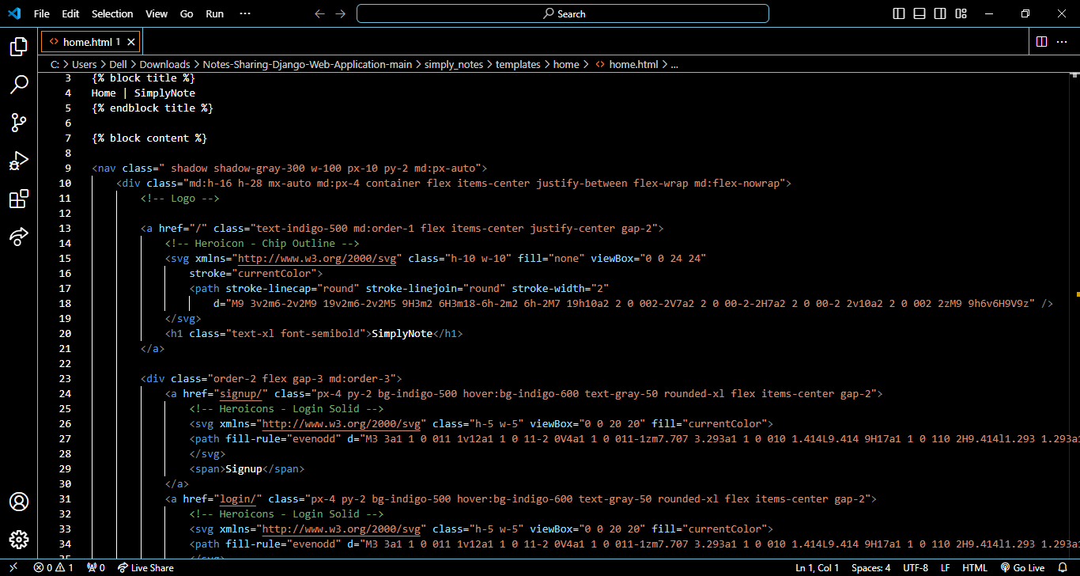
Source :github

Slide 8
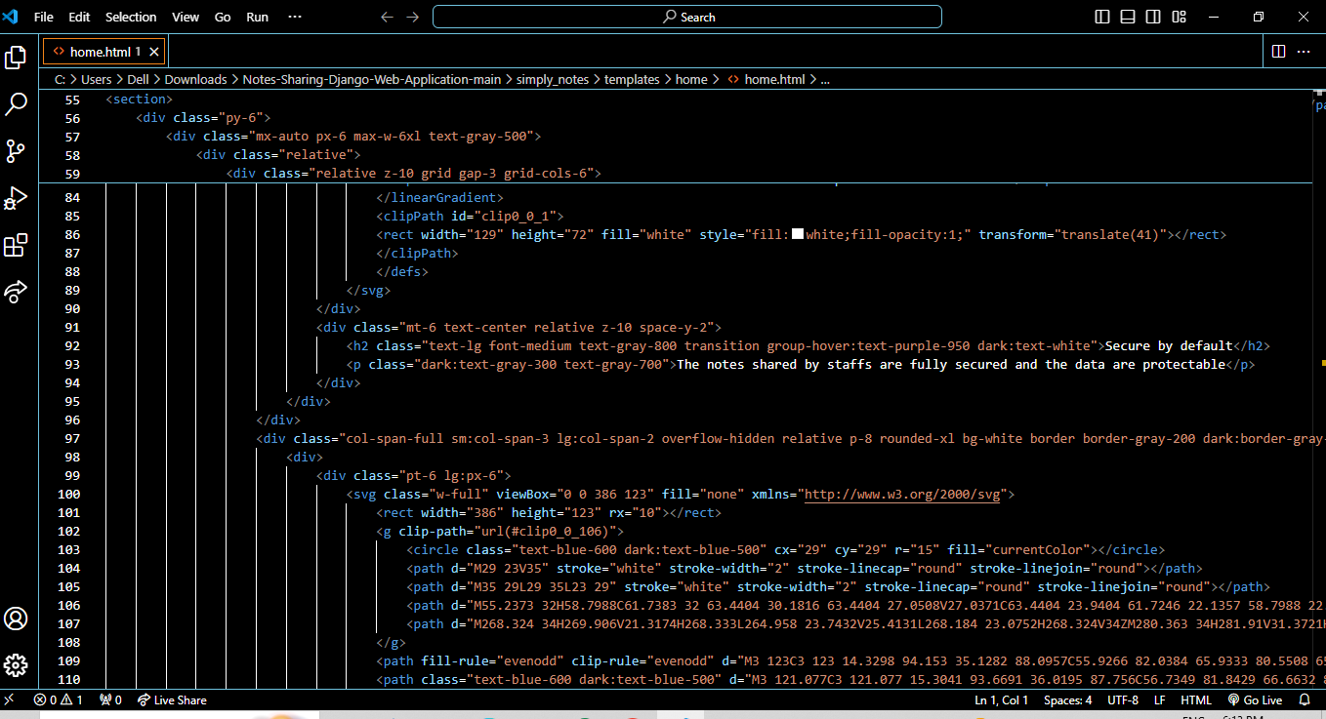

Slide 9


Technology Used
Front-end
Back-end
Source :github

Slide 10
Modelling & Results
Detailed Note Model: A comprehensive Django model will capture essential note attributes (title, content, tags, creation/modification dates, owner, permission settings, etc.).
User Model: Create a robust user model with registration, login, and profile management functionalities.
URL Structure: Well-defined URLs will facilitate seamless actions like creating, viewing, editing, and sharing notes.
Forms & Templates: Develop user-friendly forms for note creation/editing, managing permissions, and advanced search operations. Utilize Django template inheritance and inclusion for a consistent and maintainable UI.
Source :github

Slide 11
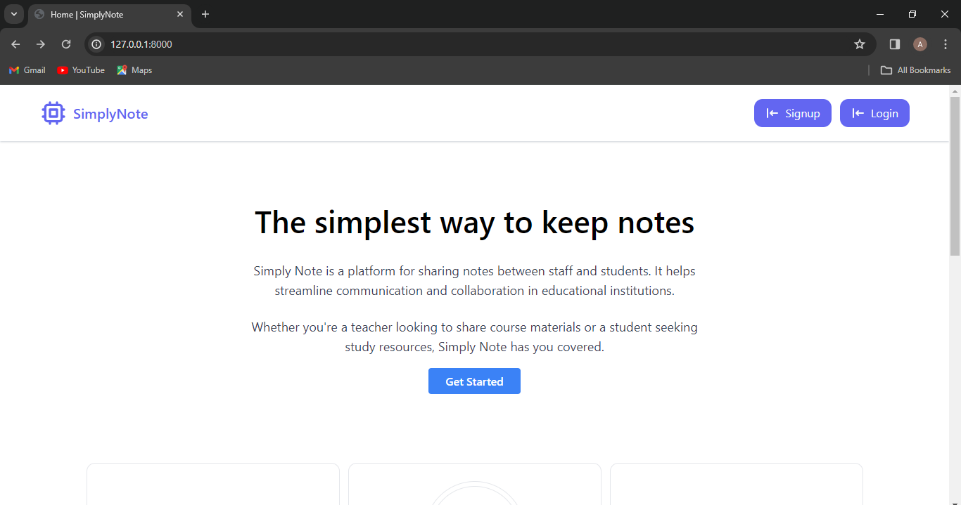
Homepage

Slide 12
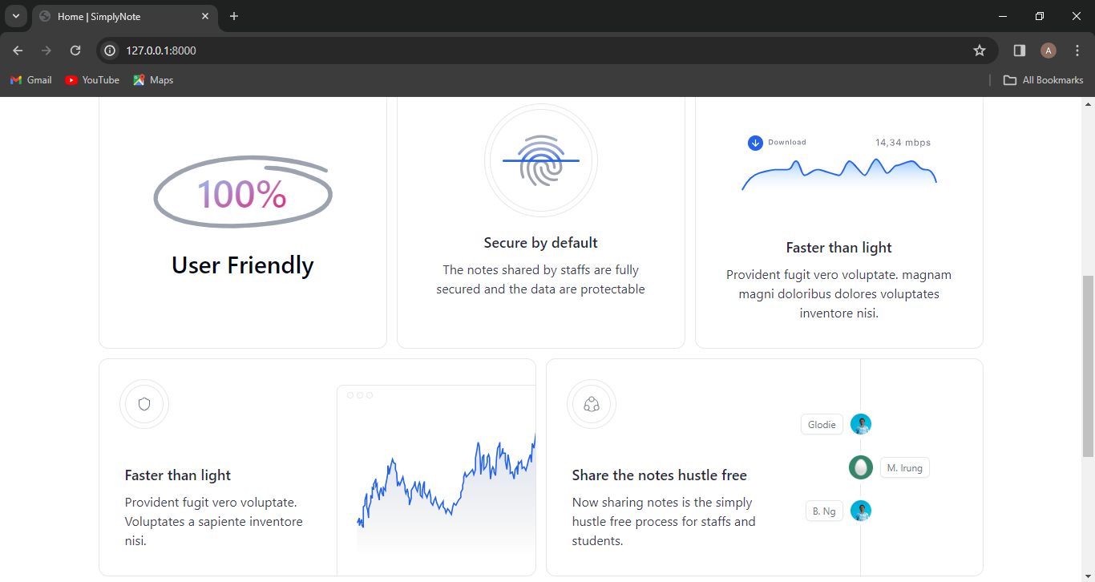
About-Us-Page

Slide 13
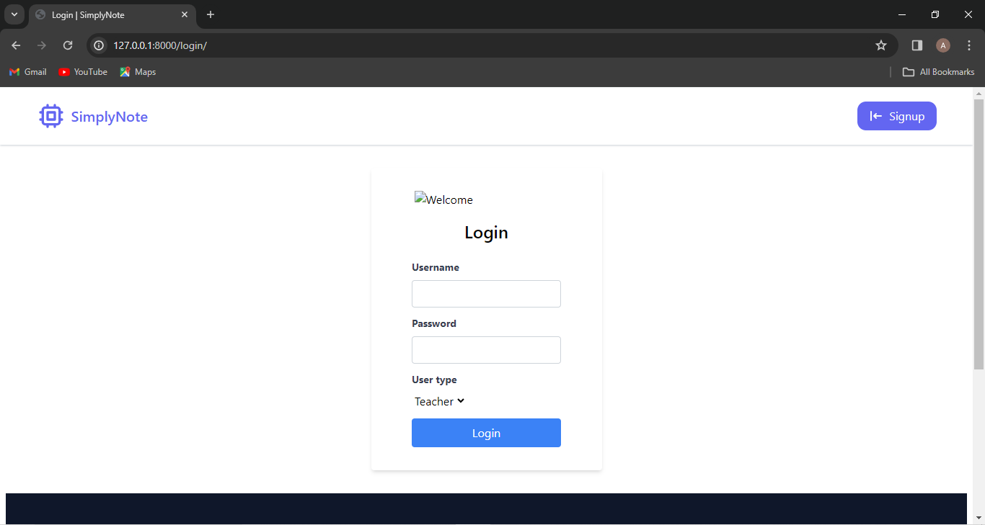
Log in page

Slide 14
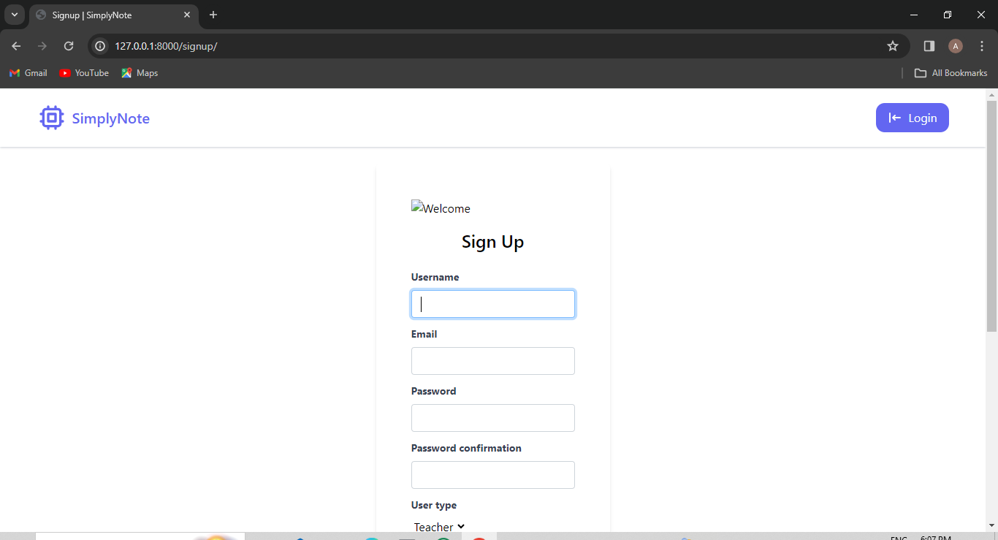
Signup page

Slide 15
Future Enhancements:
Real-time collaboration: Implement features like shared cursors or live editing for simultaneous note updates by multiple users.
Version control: Integrate a version control system to track changes and allow reverting to previous versions, if necessary.
Mobile application: Develop a mobile app to provide seamless note access and management on the go.
Advanced search: Explore full-text search capabilities or filtering based on specific criteria.
Integration with productivity tools: Integrate CollaNote with other popular productivity tools (e.g., calendars, project management platforms) to streamline workflow.

Slide 16
Conclusion
CollaNote, a Django-based notes-sharing web application, holds the potential to transform how users create, organize, and share their notes. By combining user-friendly features, robust security measures, and planned enhancements, CollaNote can become a valuable tool for collaborative note-taking and knowledge sharing.
Source :github

Slide 17
Thank You!
Notes:
Thank You !!

